Slide 1

DP-I Review On “TimeTable Scheduling”
BRACT's Vishwakarma Institute of Information Technology , Pune-411048 Department of Artificial Intelligence and Data Science
Presented by
Vishwajeet Desai Roll No:371015
Siddhesh Mali Roll No:371037
Revak Pandkar Roll No:371043
Shreyash Rahinj Roll No:371045
Guided By
Prof. Prema Kadam
27-09-2023

Slide 2
Problem Statement
Genetic Algorithm-Based Timetable Scheduler Application
Introduction
The primary objective is to create an application that can efficiently generate timetables for classes , considering factors such as room availability, faculty availability , etc.
The system should be able to detect and resolve conflicts that may arise due to resource unavailability, overlapping schedules, or other constraints.

Slide 3
MOTIVATION
Timetable scheduling is quite a complex task which involves numerous variables such as course offerings, availability of faculties, availability of classrooms/labs, room allocation, etc.
Manual Scheduling often leads to conflicts,errors and is also time consuming
SCOPE
Create a scalable and adaptable solution that can meet the needs of various types of educational institutions.
Conduct rigorous testing, including unit testing, integration testing, and user acceptance testing, with a specific focus on educational use cases.
The future scope of the project is dynamic, with opportunities to continually improve scheduling processes

Slide 4
Gap Analysis
Current State
Desired Future State
Educational Institutes primarily rely on manual methods for timetable scheduling
An automated system can optimize scheduling process
Scheduling is a time-consuming and resource intensive task
The application can significantly reduce time and resource required for scheduling
The process is often prone to errors and conflicts
Timetable can be scheduled to suit constraints and hence can help in minimizing conflicts
Sub-Optimal timetables can lead to dissatisfaction among students, faculty & administrators
Improved timetables can lead to satisfaction and cater needs of students & faculties

Slide 5
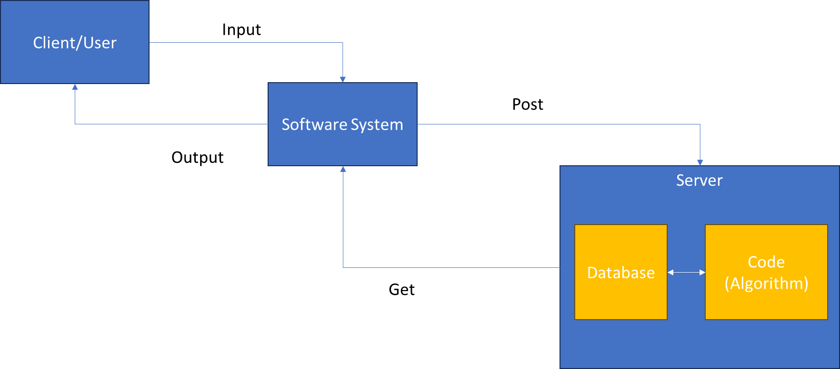
System Architecture

Slide 6
Data Flow Diagram
Students
Publish
Send
Results
Website
Teachers
Output
Rejected
Timetable Generating System
Accepted
Courses , Teachers & other details entry operators
Solution Fitness Check
Continuously Generating Data and Saving
Database Management System
Processing
Input
02-11-2023
6

Slide 7
System Diagrams

Slide 8
Modules
UI Module :
User profiles and secure authentication.
Input forms for scheduling rules and constraints.
Creation of tables for clarity
User friendly dashboards
Scheduling Module:
Genetic Algorithm-based scheduling core.
Resource allocation for classrooms and faculty.
Conflict resolution for minimizing overlaps.

Slide 9
Modules
Database Module:
PostgreSQL database management system.
Storage and retrieval of scheduling data.
User profile data storage.
PDF Export Module:
PDF generation and conversion functionality.
User-initiated PDF download feature.
Choice of different timetable views before PDF generation.

Slide 10
Objectives
The primary objective of our project is to develop an automated system of timetable scheduling
To minimize the conflicts in scheduling including overlapping of classes
Create a system that does not depend on manual interference and thereby reducing time and effort helping in increase in the overall effeciency
Applications
Academic Timetable Scheduling
Course Scheduling
Exam Scheduling
Resource Management
Event Scheduling
Adaptive Scheduling

Slide 11
Literature Survey
Selection Operations:
- Roulette Wheel Selection
- Enhancements: Elitism Selection
CrossOver Operations:
- Single Point Crossover
- Enhancements: Two Point Crossover
Uniform Crossover
Constraints:
- Required hours for each Subject
- Faculty can’t take two lectures at once
- Enhancements: Differentiate between normal lectures and labs

Slide 12


Proof Of Concept
NORMAL
ENHANCED

Slide 13
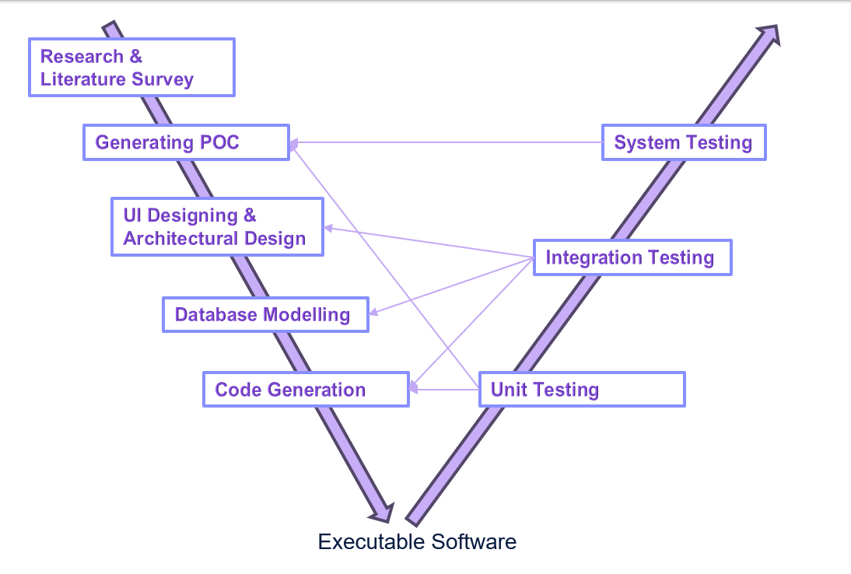



Software Requirements
FLUTTER
PYTHON
POSTGRESQL

Slide 14
Conclusion
The project aims to automate and optimize scheduling processes in educational institutions.
It seeks to improve resource utilization, reduce scheduling conflicts, and enhance user satisfaction.
The practical applications of this project are extensive, ranging from academic timetable scheduling to faculty allocation, room management, and event scheduling.
The project's objectives, including customization, resource optimization, and user-friendliness
By automating and optimizing the creation of academic timetables, this project aims to improve resource utilization, minimize scheduling conflicts, and enhance user satisfaction among students, faculty, and administrators.
Thus it represents a significant opportunity to revolutionize scheduling processes in educational institutions

Slide 15
References
Automatic Timetable Generation using Genetic Algorithm.
Genetic algorithms for modelling and optimization.
An introduction to genetic algorithms
Automatic Timetable Generation using Genetic Algorithm
A Study on Genetic Algorithm and its Applications
A review on genetic algorithm: past, present, and future
The Application Research of Genetic Algorithm

